Slide 1
Identification of Right Ventricular Dysfunction
In patients with acute pulmonary embolism
Group 7: Wang Zhe, Wen Di

Slide 2
Agenda
Introduction
Acute Pulmonary Embolism
Right Ventricular Dysfunction
Objectives
Material & Methods
Simulation
Example
Limitation
Contribution
Q&A

Slide 3
Introduction

Slide 4
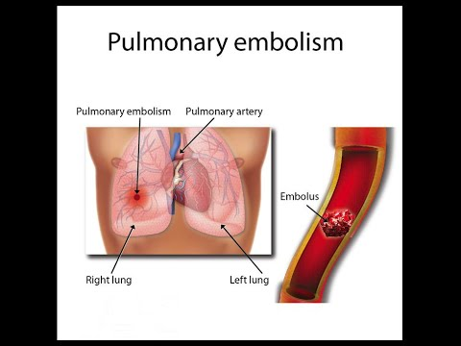
Acute Pulmonary Embolism
Acute: short duration, rapidly progressive, and in need of urgent care
Pulmonary: lung
Embolism: blood clot in the arteries or in the veins
Notes:
"Acute" is a measure of the time scale of a disease
Pulmonary embolism (PE) is the third most common of “greatest cardiovascular killers” after myocardial infarction and stroke.

Slide 5
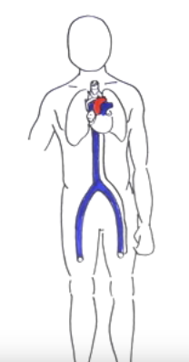
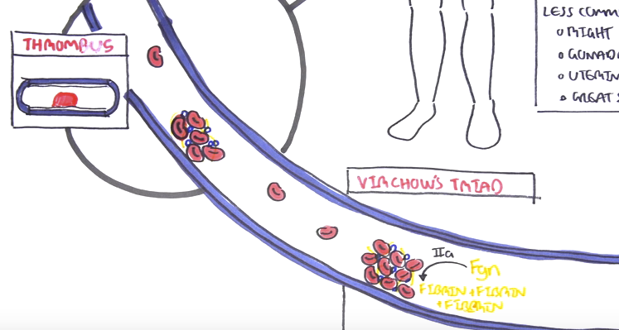
Acute Pulmonary Embolism
Signs and Symptoms
Dyspnea
Pleuritic chest pain
Tachycardia
Hypotension
Signs of DVT(Deep vein thrombosis)
Swollen leg
Pain in leg
Notes:
A pulmonary embolus can present in many different ways. There can be mild symptoms (fast heart beat, slight shortness of breath) or severe symptoms that can lead to sudden death.
Deep vein thrombosis (DVT) occurs when a blood clot forms in a deep vein in the leg or arm. There are two types of veins in the leg: superficial veins which lie just below the skin and can be seen on the surface, and deep veins which lie deep within the leg muscles. Clots usually form in the lower leg, thigh, or pelvis, but they can also form in the arm.
Depending on the size and location of the pulmonary embolus, symptoms can vary. Unlike DVTs there are usually no external symptoms. The most common presenting signs and symptoms are: shortness of breath (mild to severe), chest pain (sometimes worse with taking a deep breath), fast heart beat, and cough (sometimes with blood in sputum).
Many factors can increase your risk to develop a DVT. In general anything that slows your blood flow in the legs or makes it more likely for your blood to clot will increase your risk for DVTs: - Prolonged bed rest (such as after surgery) or sitting (traveling) - Blood clotting disorders or cancer (some cancers increase the substances in the blood that lead to clotting) - Birth control pills and hormonal replacement therapy can cause your blood to clot more easily - Trauma to the lower extremity - Family history of DVTs or PEs - Smoking (affects blood clotting and circulation) - Obesity (increased pressure on veins)
If a blood clot were to "embolize," this means it has broken loose and traveled through the circulatory system where it blocks another blood vessel. Pulmonary emboli (PE) nearly always occur in conjunction with DVT. Because the embolus blocks an artery, which in turn prevents the exchange of oxygen into the bloodstream, PE will cause a decrease of oxygen delivered to the organs and body systems.

Slide 6
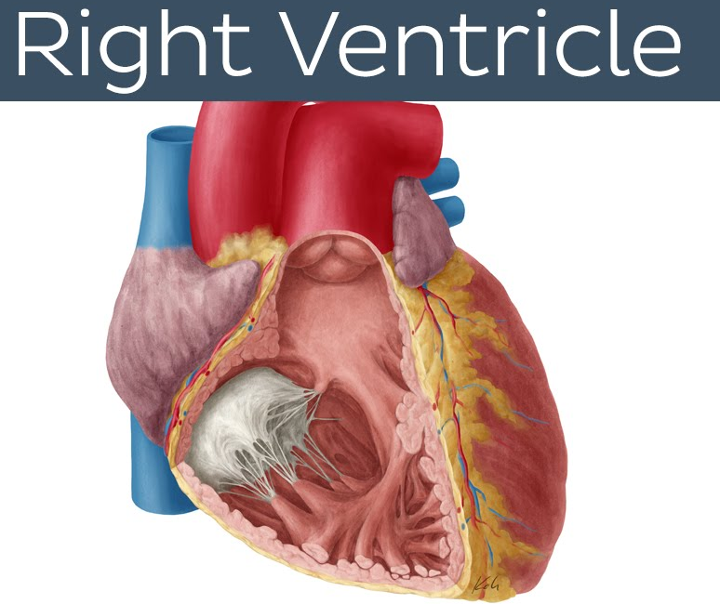
Right Ventricular Dysfunction
Right ventricle is a volume pump
Right Ventricular Dysfunction
Characterized by the RVEDD > 3 cm and the RV FAC < 25%
Most notably:
Acute increases in afterload (pulmonary hypertension)
RVEDD (Right Ventricular End-Diastolic Diameter) FAC (Fractional Area Change)
Notes:
Right Ventricle Dysfunction is characterized by the RVEDD being larger than 3 cm and the RV FAC is less than 25%
RVEDD (Right Ventricular End-Diastolic Diameter) FAC (Fractional Area Change)
The right ventricle is affected by and contributes to a number of disease processes, including perhaps most notably pulmonary hypertension caused by a variety of lung or pulmonary vascular diseases (cor pulmonale).

Slide 7
Objectives
Create a logistic regression model
Identify Right Ventricular Dysfunction (RVD) in patients with PE reliably
Use computed tomography pulmonary angiography (CTPA)
Notes:
calculate a logistic regression model for reliable identification of right ventricular dysfunction (RVD) in patients diagnosed with computed tomography pulmonary angiography.
Diagnosis of right ventricular dysfunction in patients with acute pulmonary embolism (PE) is known to be associated with increased risk of mortality.

Slide 8
Material & Methods

Slide 9
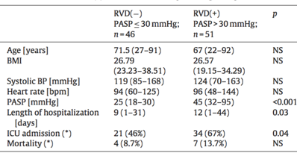
Patients Characteristics
Identified 97 patients
Age: 22-92
RVD(-) = 46 patients
RVD(+) = 51 patients
Notes:
Pulmonary artery systolic pressure (pasp)
NS = not significant
P value less than 0.05 means they are significant

Slide 10
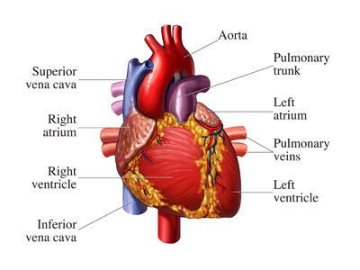
Measurements
Maximum short axis of the Right (RV) and Left (LV) Ventricle
Diameter of the pulmonary artery (PA)
Diameter of superior vena cava (SVC)
Diameter of inferior vena cava (IVC)
Diameter of coronary sinus (CS)
Notes:
pulmonary artery carries deoxygenated blood from the heart to the lungs.
a large vein carrying deoxygenated blood into the heart. There are two in humans, the
inferior vena cava (carrying blood from the lower body) and
the superior vena cava(carrying blood from the head, arms, and upper body).
The coronary sinus is a collection of veins joined together to form a large vessel that collects blood from the heart muscle (myocardium). It delivers deoxygenated blood to the right atrium

Slide 11

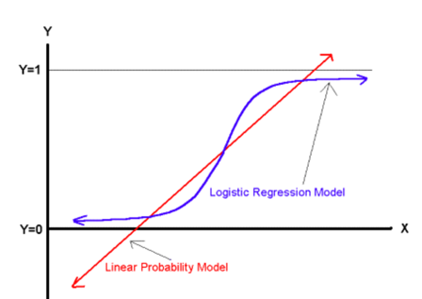

Methods – Logistic Regression
SPSS
95% confidence limits
P value ≤ 0.05
Multivariate logistic regression model
Notes:
95% of the intervals would contain the population mean

Slide 12
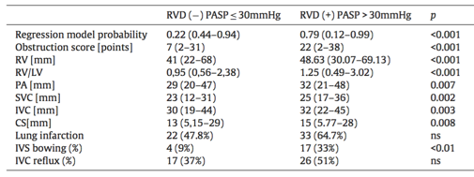
Accessed Parameters

Slide 13
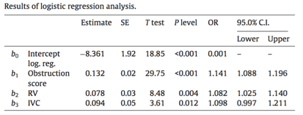
Determine Best Parameters
Backward conditional stepwise method was used to select the parameters

Slide 14
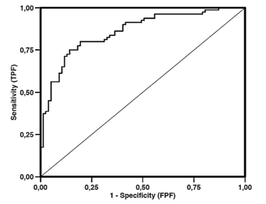
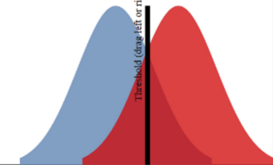
Obtained Model
Z = -8.361 + 0.132 x Obstruction score
+ 0.078 x RV +0.094 x IVC
AUC = 0.860, 95% Confidence Interval
Notes:
95% of the intervals would contain the population mean

Slide 15

How well does the model fit the data?
Hosmer-Lemeshow test
A statistical test for goodness of fit for logistic regression models
Frequently used in risk prediction models
Result
P = 0.930
Shows a good fit of model
Here Og, Eg, Ng, and πg denote the observed events, expected events, observations, predicted risk for the gth risk decile group, and G is the number of groups.
Notes:
95% of the intervals would contain the population mean

Slide 16
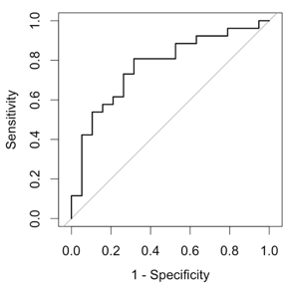
Simulation - R Code
library(pROC)
library(ResourceSelection)
setwd('/Users/wang/Desktop')
data = read.csv('project.csv')
mod <- glm(data$Z~data$Obstruction+data$RV+data$IVC, family="binomial")
summary(mod)
predpr <- predict(mod)
roccurve <- roc(data$Z ~ predpr)
plot(roccurve,legacy.axes=TRUE)
hoslem.test(mod$y, fitted(mod), g=10)

Slide 17
Example

Slide 18
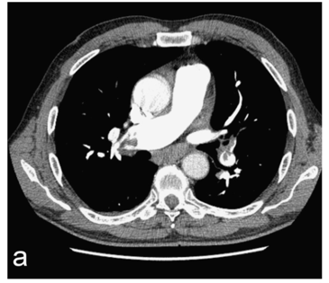
Pulmonary Severity was graded with the pulmonary obstruction score
Obstruction score = 20

Slide 19
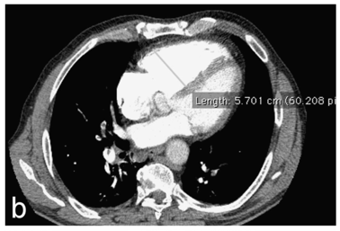
Short axis diameter of right ventricle (RV) = 57 mm

Slide 20
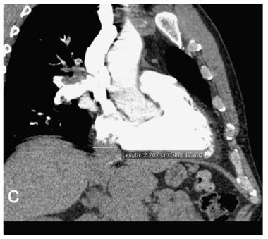
Diameter of Inferior Vena Cava (IVC) = 27 mm
Probability of right ventricular dysfunction (RVD) = 0.78

Slide 21
-8.361 + 0.132 x 20 + 0.078 x 57 +0.094 x 27 = 1.263
1/(1+e^-1.263) = 0.7795

Slide 22
Challenges
Substantial overlap in symptoms and signs of both disorders
Dyspnea (breathing difficulty) is commonly reported symptom in both disorders
Heart failure patients often demonstrate signs of right ventricular dysfunction in the absence of PE
Pulmonary vascular congestion or systemic hypertension should be stabilized before undergoing chest CT
Notes:
http://circ.ahajournals.org/content/118/15/1598.full#ref-7

Slide 23

Limitation
Retrospective study
Only use existing data
Continue with Prospective Study
Notes:
Due to the retrospective character of the study, which is designed to analyze pre-existing data that are collected from medical records of patients, the level of evidence could be inferior compared with prospective studies. The result may be prone to selection bias and not representative of the general population if convenience sampling influences control. Therefore, further evaluation of applicability of the calculated logistic regression model should be carried out on a larger group of patients.

Slide 24

Contribution to Healthcare
Reliable Assessment of RVD in the course of the acute PE
Performed better than single CT-based measurements
Notes:
Knowledge about the role of the right ventricle in health and disease historically has lagged behind that of the left ventricle.
Consequently, comparatively little attention has been devoted to how right ventricular dysfunction may be best detected and measured
Therefore, the study would help improve doctors’ diagnosis of right ventricular dysfunction symptoms in patients with acute pulmonary embolism. Consequently improve the quality of healthcare in the area of treating and healing such disease by increasing the reliability, sensitivity and specificity of the identification.

Slide 25
Question And Answer

